Slide 1
GRADUATION ANALYSYS
VOIP application

Slide 2
CHAPTER 1
introduction

Slide 3
Background
Company Chatting is an application that provides communication services within a local network, works on the Windows and Android environment, the application provides three main services which are voice communication, text messaging and file sharing.
Voice communication allows the exchange of communications between two devices connected to the same LAN network using network protocol.
Messaging allows the user to exchange messages with any other user linked in the same network.
File transfer allows the exchange of files (doc, pdf, video, image) over the network.

Slide 4
Problem Statements
The cost of creating an extension.
Shunt maintenance cost.
The cost of extending the shunt.
The extension is limited to providing voice communication only.
Not to exploit resources like a computer.

Slide 5
Objectives
Eliminate the electric shunt and wired connections within the organization by adding the voice communication service through an application that installs via a computer or phone.
The application provides several services for communication.
More and better use of the computer systems.

Slide 6
Acceptance Criteria
Create an account for each user within the same network.
Providing voice communication, message exchange and file exchange service.
The application is safe because it works on the local network and does not work through the internet.

Slide 7
System Definition
It is an application that works on the Android and Windows environment dedicated to various institutions and is characterized by its provision of voice communication services and the exchange of files and messages within the institution's local network

Slide 8
Purpose
Facilitating the process of communication within the organization, the optimal utilization of resources, and the provision of infrastructure through dispensing of switching networks.

Slide 9
Goal
Creating an application for Windows and Android devices dedicated to communication over the local network.

Slide 10
User Characteristics
Tasks | Required skills | Qualifications | User type
1- Distribute the program to all devices connected to the network 2- Installation, maintenance, and administration of the program. | 1 - Windows server 2- Full knowledge of the enterprise network 3- Full knowledge of how the application works | 1- CCNA, CCNP, MCSA 2- Bachelor's degree in 3- Computer Specializations | Administrator
Choose any device connected to the network and communicate with | Use of the computer | - | Employee

Slide 11
Limitations
Low TCP / IP resources.
The geographical distance between the team members is making it difficult to communicate.
Availability of the internet permanently.
Some of the devices used in the system building process do not have the required resources.

Slide 12
Assumptions and Dependencies
Hiring an expert in programming the network protocols.
Dividing business among team members.
Insert a mobile internet provider
Borrowing devices that meet the required standards

Slide 13
Scope
Institutions and companies.

Slide 14
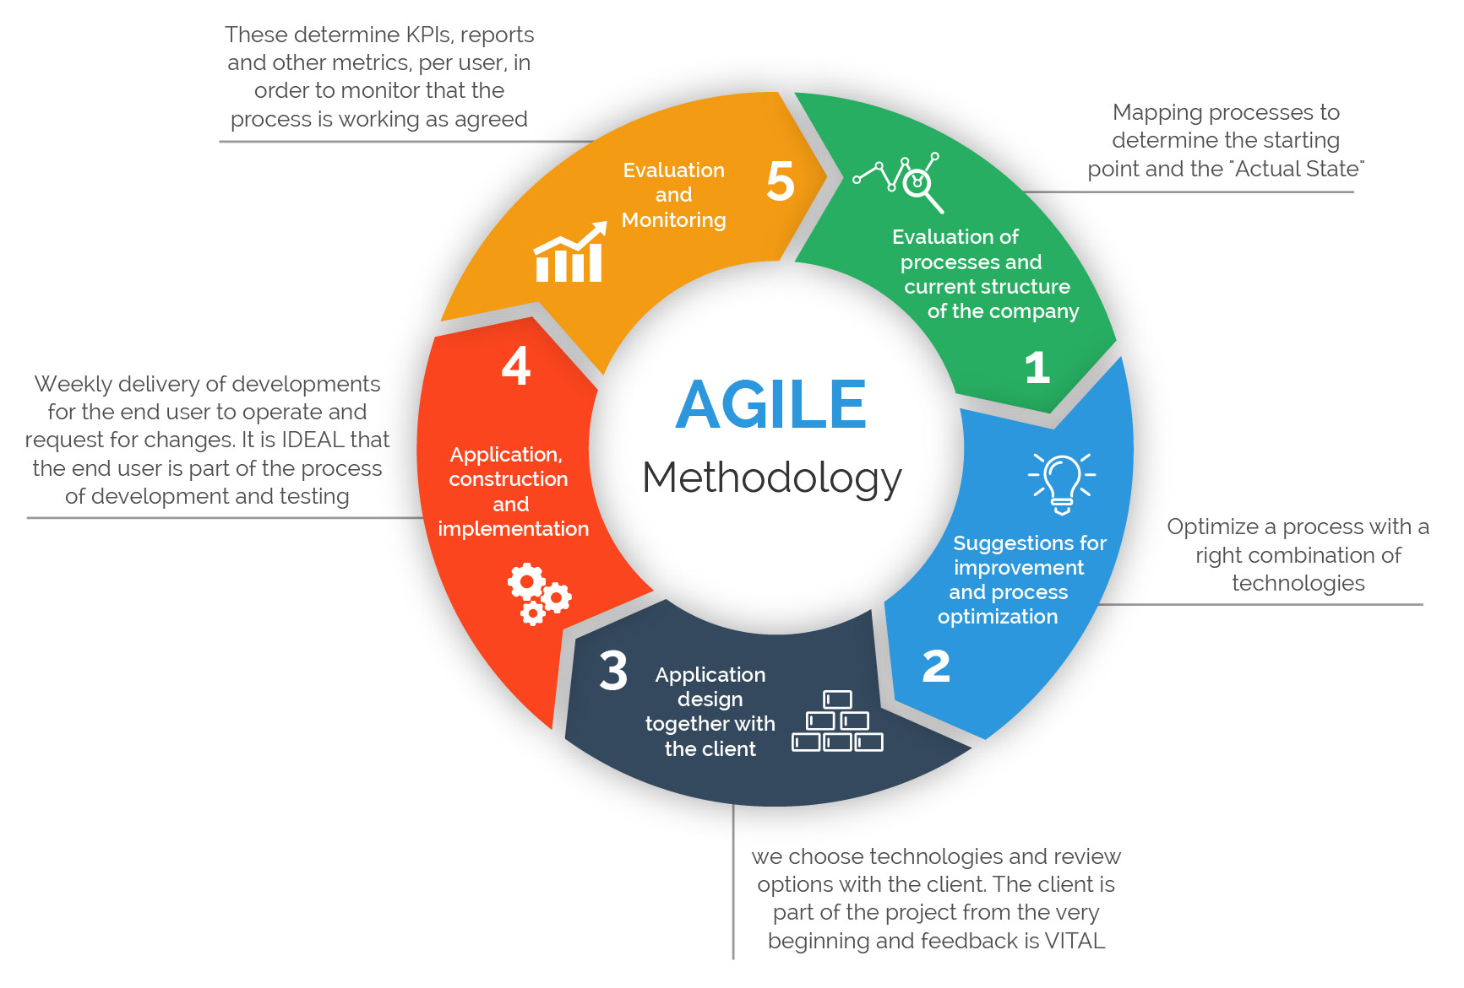
Life Cycle Model

Slide 15
Related Work
Needs fixing

Slide 16
Project Plan
Needs fixing

Slide 17
Feasibility Study

Slide 18
Technical Feasibility
Needed Hardware
Available Hardware
Needed Software
Needed Experts

Slide 19
Financial Feasibility
Total | Cost | Quantity | Type | Category
1200$ | 200$ | 6 | laptop | HW
22 | 22 | 1 | modem
4$ | 4$ | 10m | Cable
6$ | 1$ | 6 | Win10 | SW
1$ | 1$ | 1 | Win server
12$ | 2$ | 6 | Visual studio
8$ | 4$ | 2 | Android studio
1$ | 1$ | 1 | MS project
6$ | 1$ | 6 | MS world
12$ | 2$ | 6 | SQL server
6$ | 1$ | 6 | Virtual Machine
6000R.y | Kw300 | Kw20 | Electricity Budget | Other
60000 R .Y | 60000R.Y | ------- | Transportation
23 R.Y | 4750\36GB | 150GB | Internet

Slide 20
Operational Feasibility
Performance
Response time
Economy
Control
Efficiency
Effort
Services
Legal Feasibility

Slide 21
Scheduling Feasibility (planning the time)
Need Fix

Slide 22
Identifying Benefits and Costs
Tangible benefits
Intangible benefits
Tangible costs
Intangible costs

Slide 23
CHAPTER 2
Current system

Slide 24
Current system
Needs Fixing

Slide 25
CHAPTER 3
PRUPOSED system

Slide 26
Overview
In this chapter, will refer to clarification of application requirements that include functional and nonfunctional requirements and other requirements.

Slide 27
Fact Finding Tools
Searching at professional web sites (e.g. Stackoverflow , Github , Codepen,…etc.).
Books about TCP/IP programming.
Blogs and forums.
Technical YouTube channels.
Similar existing applications.

Slide 28
Requirement specifications User Requirements
Ease of use by providing simple user interfaces which make user recognizes them quickly.
High security while data transmitted back and forth.
High performance at processing requests.

Slide 29
Requirement specifications Functional Requirements
Making Calls
File Sharing
Instant Messages

Slide 30
Requirement specifications Non-Functional Requirements / Usability
The Application offers easy and simple graphical interfaces, which means user can understands and uses the application easily which result in obtaining user satisfaction.

Slide 31
Requirement specifications Non-Functional Requirements / Dependability
Dependability
The application effectively carries out all tasks that mentioned in the functional requirements so that it performs tasks quickly and accurately.
Robustness
The application can handle with errors, which cannot lead to failure. For example, if the user enter invalid datatype of a particular field it shows an error message to inform the user that there is an error and how to fix the error.
Safety
The application does not pose any risks at worst because it is not kind of critical systems, which consider safety as an important factor to keep running.
Security
The application is difficult to be tracked by any external entity because connecting to the internet is not required and working only at the organization's local network and the administrator have all privileges to do what is needed if there is any violations or breaches.

Slide 32
Requirement specifications Non-Functional Requirements / Performance
Response Time
It has been considered that response time should quickly even if in the peak time, but there are several factors to determine response time such as hardware infrastructure, number of users, geographical space and other factors not mentioned.
Throughput
It depends on process type that is required to be performed in addition to the network response.
Availability
The application must be available when the device is connected to the network.
Accuracy
The application is accurate as it sends only valid data and if there is an error user is informed.

Slide 33
Requirement specifications Non-Functional Requirements / Supportability
Adaptability
The application is compatible with computers that working on Microsoft Windows or smart phones working on Android.
Maintainability
The application is flexible, so it is possible to add, remove, or modify services and updates available by developers of the application and easily solving problems when they occur.
Internationalization
The application is universal as it supports Arabic, English language and any other languages ​​if needed.
Portability
The application can be moved to another environment if one condition is met, in which the previous and new environment infrastructure is the same.

Slide 34
Requirement specifications Non-Functional Requirements / Validation
Completeness
The application is integrated, in terms of user can interact with others within the organization by making voice calls and sending or receiving messages.
Consistent
There is no conflict between elements and other processes because it cannot occur any overlap in executing processes among users, which performed separately and accurate to ensure that processes are not overlapped.
Unambiguous
The application is clear and does not contain ambiguity.
Correctness
The program works according to criteria that ensure work continuation with high accuracy and reliability to avoid problems and errors that may occur.

Slide 35
Requirement specifications Non-Functional Requirements / Other
Verification
The application undergoes several rigorous tests to ensure the safety of the application in terms of performance and processing.
Realistic
The application is realistic that it implements requirements under restrictions.
Traceable
The application can be traceable, that all processes are recorded in central database which allows administrator to check records if problems happened.

